Slide 1
Machine Learning

Slide 2
Artificial Intelligence (AI)
The term Artificial Intelligence was only coined in 1955 by John McCarthy as “the science and engineering of making intelligent machines.
The goal of AI is to teach computers to do things that humans do, only better.

Slide 3
Turing
Alan Turing was well known for the Turing Test which he developed in 1950.
It is a test of a machine’s ability to exhibit intelligent behaviour equivalent to that of a human.

Slide 4
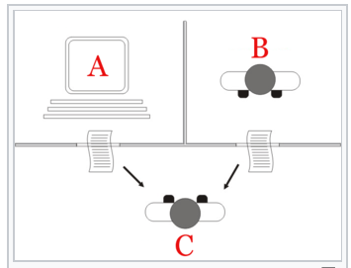
Turing Test
Interpretation of the Turing Test:
Player C, the interrogator, is given the task of determining which player - A or B - is a computer and which is human.
The interrogator is limited to using the responses to written questions to make the determination.

Slide 5


Slide 6
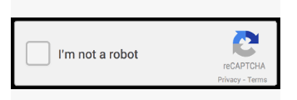
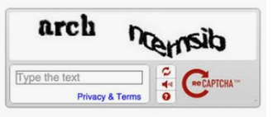
CAPTCHA
Completely Automated Public Turing Test to tell Computers and Humans Apart

Slide 7
“I believe that at the end of the century the use of words and general educated opinion will have altered so much that one will be able to speak of machines thinking without expecting to be contradicted”
Alan Turing 1950

Slide 8
Machine Learning
Arthur Samuel coined the term machine learning in 1959 explaining that the computer could be programmed to outplay its programmer

Slide 9
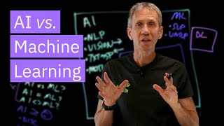

Slide 10
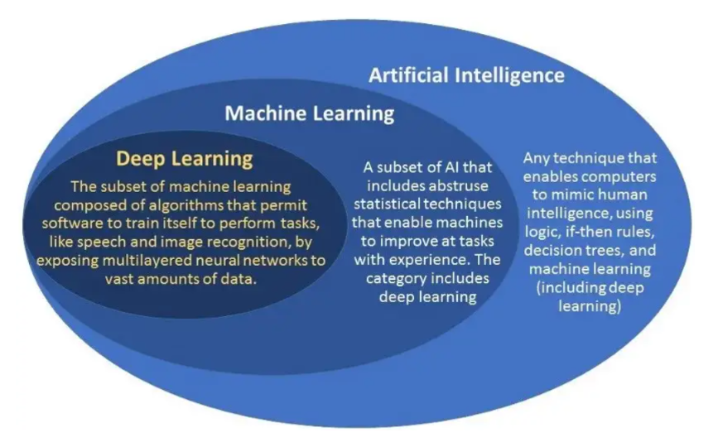
https://www.unite.ai/machine-learning-vs-deep-learning-key-differences/

Slide 11
Machine Learning (ML) Algorithms
There are two main categories of ML:
Supervised
Unsupervised

Slide 12
Supervised Learning
An artificial intelligence uses labeled data to train a model to make predictions or classify data.
Uses training (input) data and if certain outputs are incorrect, the algorithm is notified not to output this in future. It relies on good data and some feedback.
Examples:
Visual Recognition
Decision Support - email spam filter, credit risk
Medical Diagnosis
Sentiment Analysis

Slide 13
Unsupervised Learning
Allows the algorithm to spot patterns and decide itself which outputs are most useful. Does not rely on feedback.
Examples:
Human Behaviour - identifying customer buying patterns (associating items frequently bought together)
Robotics - Reinforcement learning, Object tracking
Anomaly Detection - Credit Card fraud (detecting transactions different to usual spending activity)

Slide 14
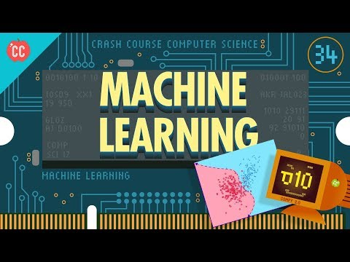

Slide 15

Modelling and Simulation
Computer modelling, simulations and data analytics are core activities of of computer science.
Models enable us to abstract key characteristics of real world systems to that they might be more easily understood or explored.
A simulations shows what happens when a model is applied in a certain situation using a specific set of data as inputs.
Analytics is about examining datasets to test hypotheses, discover patterns, examining evidence and reaching conclusions.
Modelling and simulation can be used to predict future behaviour as well as confirm what we already know about a system.

Slide 16
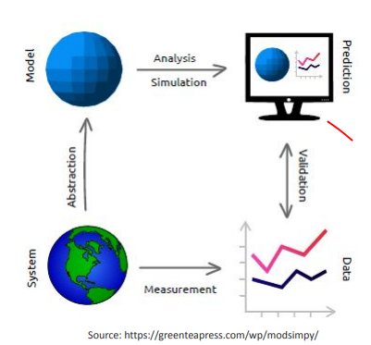
Modelling and Simulation
System is a real world system that exists
Abstract the real world system to a computer model
Use the model to make predictions by running simulations and carrying out analysis.
Any information can be stored as data. Validation can be used to compare simulated results to actual results.

Slide 17
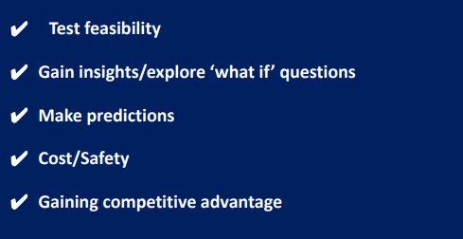
Benefits of Modelling

Slide 18
Interesting…
https://www.unite.ai/ten-best-machine-learning-algorithms/

Slide 19
https://www.unite.ai/ten-best-machine-learning-algorithms/
https://azure.microsoft.com/en-us/resources/cloud-computing-dictionary/artificial-intelligence-vs-machine-learning
https://www.rte.ie/brainstorm/2023/0913/1404873-jobs-occupations-generative-ai/

